Slide 1


The Next Frontier
Wake Forest
School of Business
_______
AutoML & xAI

Slide 2

Agenda
AutoGluon
Tabular
Timeseries
Text
Image
xAI (Explainable AL)
Global Explanations
Local Explanations
A gluon is a fundamental particle in the field of quantum physics, responsible for holding quarks together within protons, neutrons, and other hadrons.
Gluons act as the exchange particles, or force carriers, for the strong force, much like photons are the force carriers for the electromagnetic force.

Slide 3
What and Why
AutoGluon is an open-source Automated Machine Learning (AutoML) library designed to simplify and automate the process of developing and optimizing machine learning models.
Developed by Amazon Web Services (AWS), AutoGluon enables both novices and experts in machine learning to achieve high-quality model performance with minimal effort and time.
Key capabilities of AutoGluon include:
Ease of Use: AutoGluon offers a user-friendly API where you can train several models with just a few lines of code.
Broad Support for Data Types: It supports a wide range of data types and tasks, including tabular data for classification and regression, text for natural language processing tasks, images for computer vision challenges and now timeseries forecasting.
State-of-the-Art Performance: AutoGluon provides models that are competitive with state-of-the-art approaches by automatically employing advanced techniques such as ensembling, stacking, and neural networks.
Customization and Flexibility: While AutoGluon can automate the entire machine learning process, it also offers flexibility for users to customize and experiment with different models, hyperparameters, and data preprocessing techniques.
Efficiency and Scalability: Designed with efficiency in mind, AutoGluon can scale from modest datasets on a single machine to large datasets requiring distributed computing resources.

Slide 4
AutoGluon Components
Tabular Prediction: TabularPredictor().
Overview: The Tabular Prediction component is tailored for supervised Classification and Regression learning tasks with structured data.
It can automatically preprocess the data, select models, and optimize their hyperparameters to predict outcomes for new data.
Key Features: It supports a wide range of models including decision trees, random forests, gradient boosting machines, deep neural networks, and ensembles of these models.
AutoGluon's Tabular Prediction can handle missing values, categorical and continuous features, and even automatically engineer new features to improve model performance.
Time Series Forecasting: TimeSeriesPredictor()
Overview: AutoGluon can forecast the future values of multiple time series given the historical data and other related covariates. AutoGluon TimeSeriesPredictor method trains multiple models to generate forecasts and does not require you to manually deal with cumbersome issues like model selection and hyperparameter tuning.
Key Features:
Under the hood, AutoGluon combines various state of the art forecasting algorithms and established statical methods like ETS and ARIMA from StatsForecast, efficient tree-based forecasters like LightGBM, and flexible deep learning models like DeepAR and Temporal Fusion Transformer from GluonTS.
Tabular and Timeseries

Slide 5
AutoGluon Components
Text Prediction: TextPredictor()
Overview: The Text Prediction component specializes in processing natural language data. It simplifies the application of state-of-the-art natural language processing (NLP) models to tasks such as text classification, sentiment analysis, and more.
This component leverages recent advances in NLP, such as transformer-based models, to understand and predict outcomes based on textual content.
Key Features: AutoGluon Text Prediction automates the entire NLP pipeline, including text preprocessing, tokenization, embedding, and the application of complex models like BERT and its variants.
It's designed to provide high-quality predictions with minimal input from the user, making advanced NLP accessible to non-experts.
Image Prediction
Overview: The Image Prediction component is designed for computer vision tasks. It enables users to train models capable of understanding and interpreting visual data from images. This component is suitable for tasks like image classification and object detection.
Key Features: AutoGluon Image Prediction facilitates the use of convolutional neural networks (CNNs) and other advanced models for analyzing images.
It includes pre-processing steps such as image resizing and normalization, and it allows for fine-tuning of pre-trained models on custom datasets, leveraging transfer learning to achieve high accuracy even with relatively small datasets.
Text and Image

Slide 6
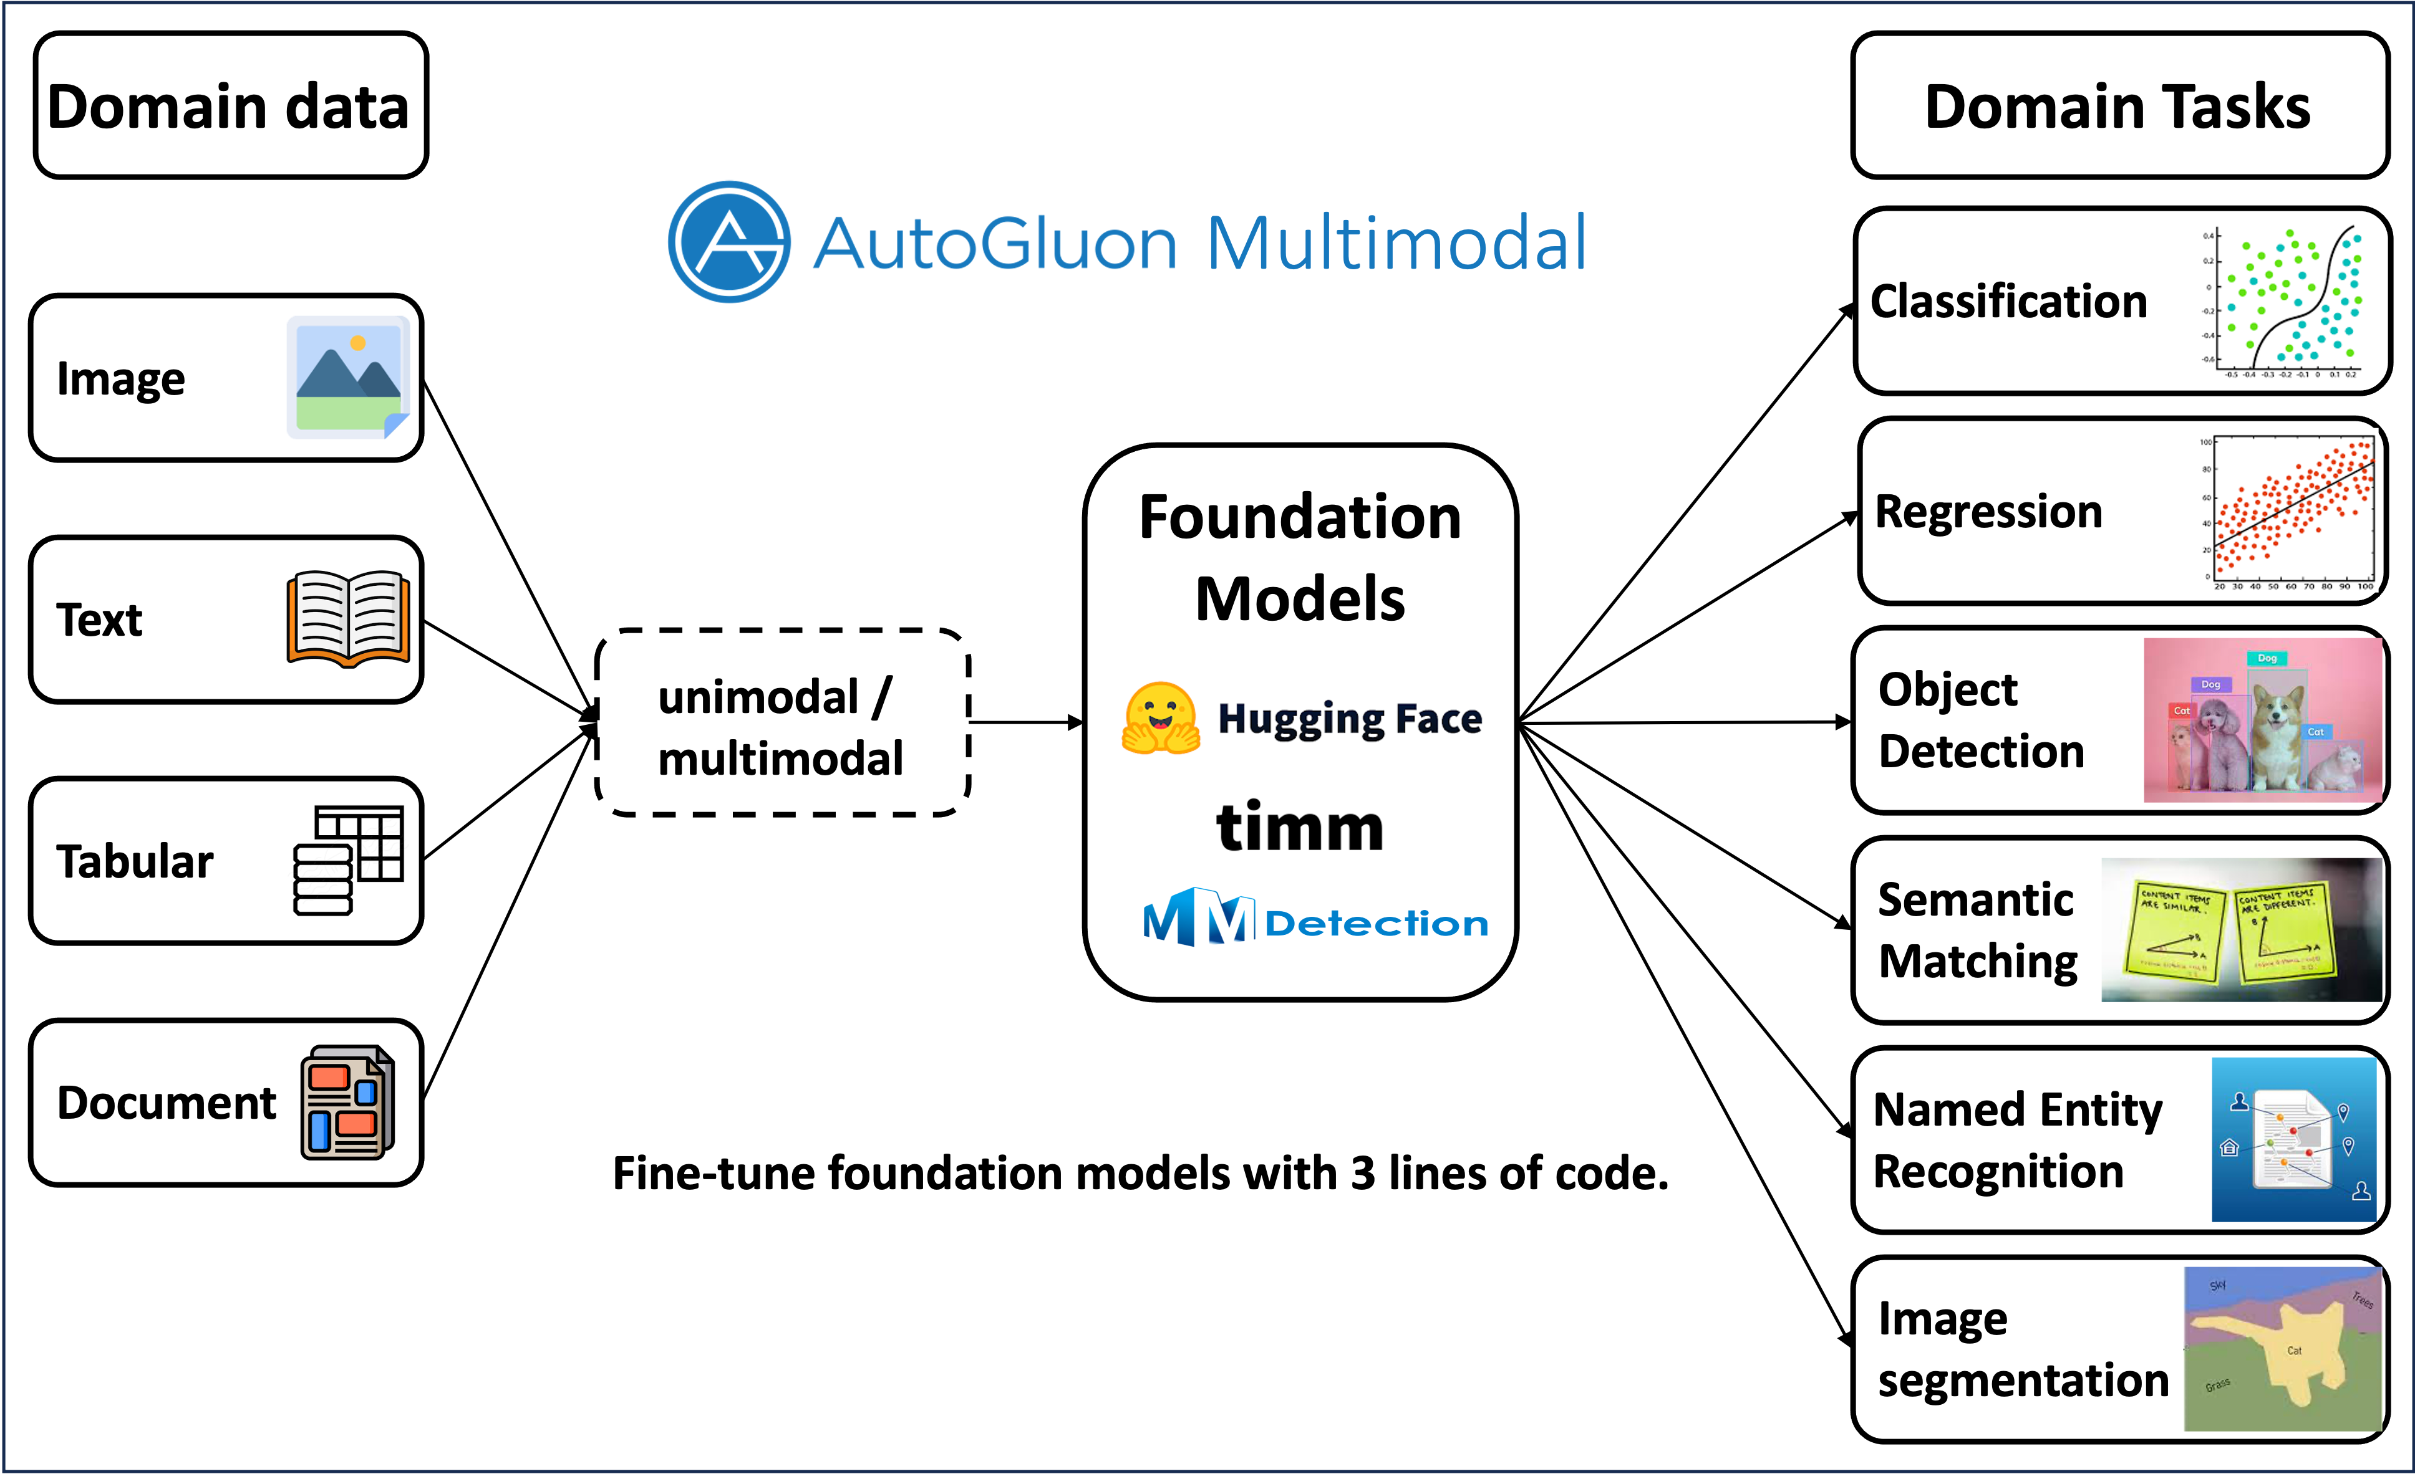
MultiModal
What do you want to do.. One package to rule them all.

Slide 7
Recipe for AutoGluon
Install AutoGluon
!pip install autogluon.tabular
Import AutoGluon Tabular
from autogluon.tabular import TabularPredictor
Load Your Dataset & train/test split it
data = pd.read_csv('data.csv’)
train_data = data.sample(frac=0.8, random_state=42)
test_data = data.drop(train_data.index)
Train the Model
ag_model = TabularPredictor(label=label)
ag_model.fit(train_data)
Evaluate the Model
performance = predictor.evaluate(test_data)
Make Predictions
predictor.predict(test_data_nolabel)
6_2_AutoGluonExample.ipynb

Slide 8
Some other Tutorials
TimeSeries tutorial
https://colab.research.google.com/github/autogluon/autogluon/blob/stable/docs/tutorials/timeseries/forecasting-quick-start.ipynb
Object Detection
https://auto.gluon.ai/scoredebugweight/tutorials/object_detection/beginner.html
Text
https://auto.gluon.ai/scoredebugweight/tutorials/text_prediction/beginner.html

Slide 10
Behind The Black BoX: How To Understand Any Ml Model Using SHAP

Slide 11
Model Interpretability:
1
The Fundamental Tradeoff

Slide 12
Accuracy Vs. Interpretability
Simple Models
- Less accurate
- Extract shallow patterns from data
- Generate model interpretations that are straightforward
Complicated Models
- More accurate
- Extract perceptual, non-linear patterns
- No straightforward way to map how inputs contribute to output

Slide 13
Accuracy Vs. Interpretability
Simple Models
Linear Regression
Logistic Regression
Naïve Bayes
Decision Trees
Complicated Models
Neural Networks
SVMS
Ensembles of Trees:
RandomForest
GradientBoostingMachine
Xgboost
CatBoost
LightGBM
Etc.
Stacks Bags and More
Combinations of Different Models assembled in some way.
-

Slide 14
Complex Models
Pros of Complex Models:
High Accuracy and Performance: often capture intricate patterns in large datasets, outperforming simpler models in tasks such as image recognition, natural language processing, and complex regression or classification tasks.
Flexibility: identify non-linear relationships and interactions between features without requiring explicit feature engineering or transformation, making them versatile across a wide range of applications.
Scalability: are designed to scale with data, improving in accuracy as more data becomes available.
Cons of Complex Models:
Overfitting Risk: Without regularization, complex models can-and-will overfit to the training data, learning noise rather than the underlying patterns, which diminishes their ability to generalize to unseen data.
Interpretability and Transparency: The "black box" nature of many complex models makes it close to impossible to understand how predictions are made, which can be a significant drawback in applications requiring explain-ability, such as healthcare or finance.
Computational Resources and Time: Training complex models often requires substantial computational resources (e.g., GPUs) and time, especially for large datasets.

Slide 15
Understanding Black Box Models:
2
An Ongoing Struggle

Slide 16
Machine Learning - Lifecycle
Problem Definition, Model training, Integration to & Monitoring
1. Problem Formulation
2. Data Gathering & Structuring
12. Periodically Retrain
3. Data Exploration
4. Feature Engineering
5. Multi-Model Training
6. Model Evaluation
8. Model Calibration
10. Model Integration
11. Model Monitoring
7. Model Interpretability
9. Model Documentation
Notes:
This is what we’ve done as analytics professionals for decades. A nice 12 step process…

Slide 17


GLOBAL Interpretation
Variable Importance
Partial Dependance Plots

Slide 18
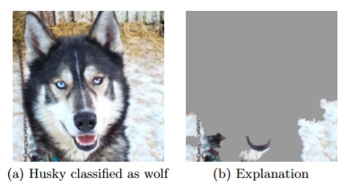
Would you trust this model?
It’s possible to build a model that is very accurate, but it loses its power if we are unable to explain why a certain prediction was issued.
In the Husky vs Wolves experiment researchers built an image recognition model that could correctly classify a Husky from a Wolf with very high accuracy.
However, after using an explanation method researchers found out that this was due to all wolves having a snowy background!
Would you trust this model?
*https://arxiv.org/pdf/1602.04938.pdf

Slide 19
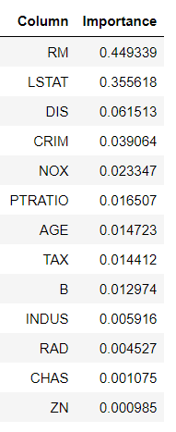
Feature Importance Alone is not enough
1. Lack of Interpretability for Complex Interactions: fail to capture complex interactions between features. Two or more features may individually show low importance but could be very influential when combined.
2. Non-Linearity and Model Complexity: Feature importance scores can oversimplify these relationships, providing an incomplete picture of how features affect predictions.
3. Data Leakage and Bias: High feature importance may be indicative of data leakage or bias in the dataset rather than genuine predictive power. Without further investigation, one might overlook issues that lead to overly optimistic performance metrics.
4. Dependence on the Model Type: Feature importance is model-dependent, meaning different models may assign different levels of importance to the same features. This variability underscores the need for a broader analysis that might include model-agnostic interpretation methods.
What direction does each feature Move the model?
How do individual values impact the model?
How do model features impact a prediction at a local level?

Slide 20
What Are Shapley Values?
“A method to fairly distribute the total gains (or "payouts") in a cooperative game among all players based on their contribution to the success of the game” - Developed by Lloyd Shapley in 1953
Each player's contribution is calculated by considering all possible combinations or coalitions they can be part of and averaging their marginal contributions across these coalitions.
Analogy: In machine learning, features in a dataset can be considered as "players" in a game where the "payout" is the prediction outcome.
Shapley values aim to determine the value of each feature by calculating its contribution to the prediction, ensuring a fair attribution of importance based on the feature's actual impact.

Slide 21
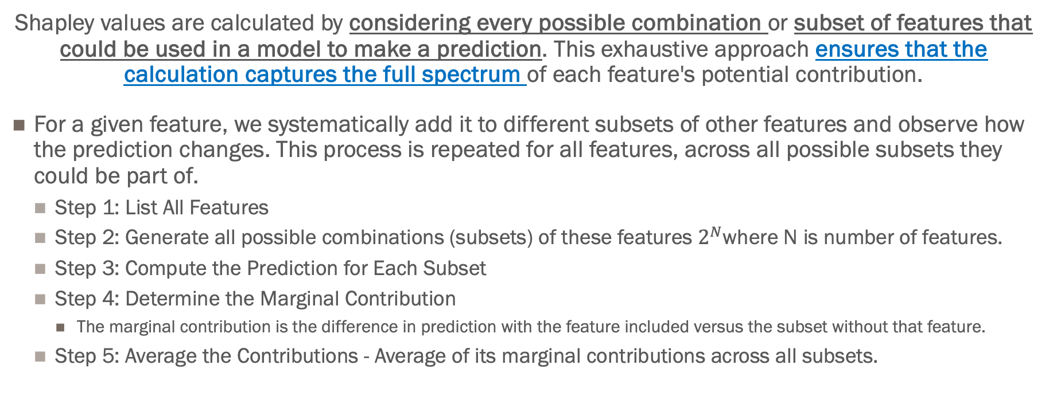
How they are calculated
Shapley values are calculated by considering every possible combination or subset of features that could be used in a model to make a prediction. This exhaustive approach ensures that the calculation captures the full spectrum of each feature's potential contribution.
For a given feature, we systematically add it to different subsets of other features and observe how the prediction changes. This process is repeated for all features, across all possible subsets they could be part of.
Step 1: List All Features
Step 2: Generate all possible combinations (subsets) of these features $2^{N}$where N is number of features.
Step 3: Compute the Prediction for Each Subset
Step 4: Determine the Marginal Contribution
The marginal contribution is the difference in prediction with the feature included versus the subset without that feature.
Step 5: Average the Contributions - Average of its marginal contributions across all subsets.

Slide 22
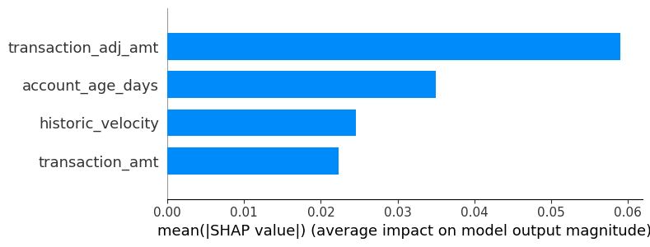
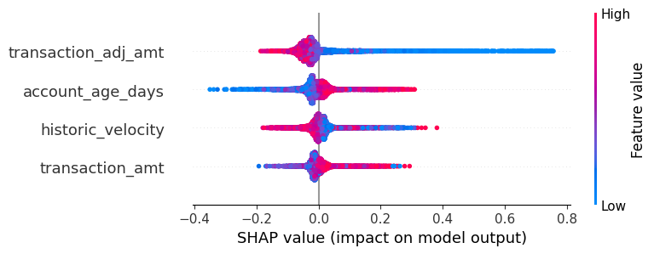
Shapley Values

Slide 23
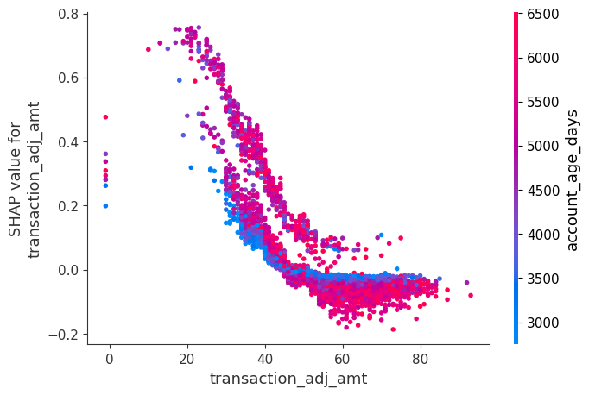
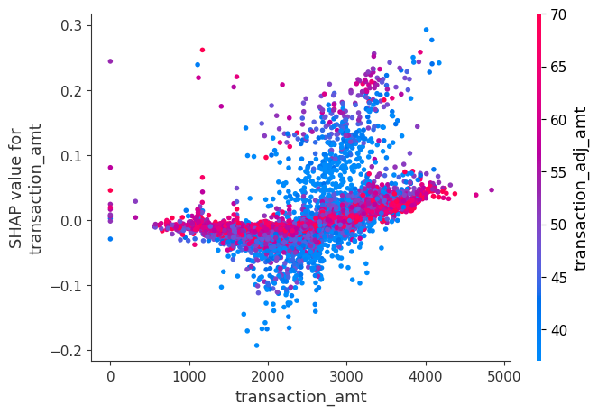
Partial Dependance Plots

Slide 24
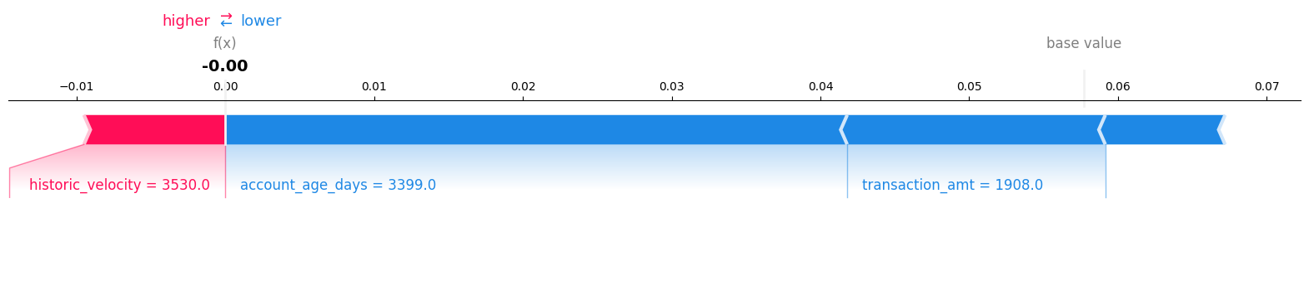
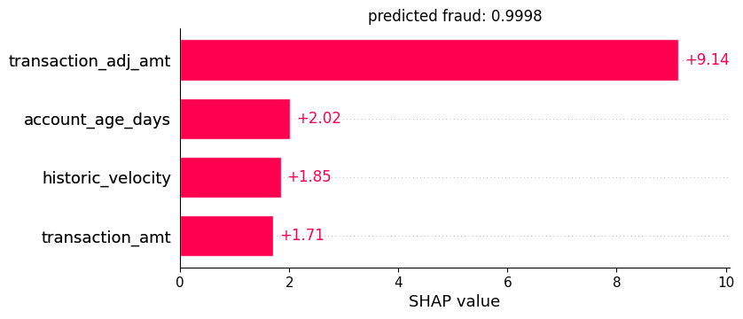
Local Predictions
Explain a single prediction

Slide 25
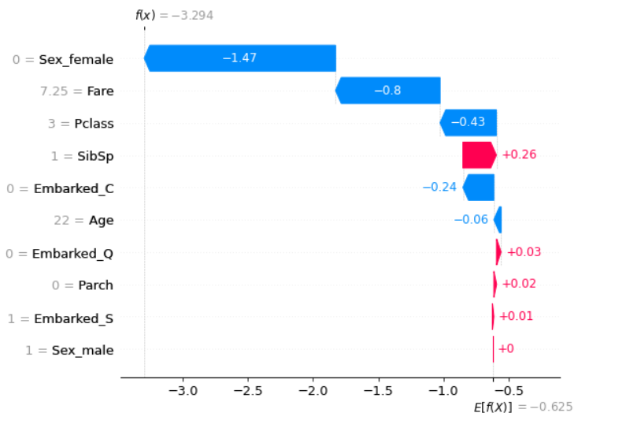
Classification
exp(-3.294) = .037 = model prediction
exp(-3.294) = .037 = model prediction

Slide 26
Main github repo: https://github.com/slundberg/shap
Original paper: https://arxiv.org/abs/1705.07874
Paper for TreeShap: https://arxiv.org/abs/1905.04610
Useful reading for interpretable ML: https://christophm.github.io/interpretable-ml-book/
Kaggle course: https://www.kaggle.com/dansbecker/shap-values
Live production example of shap: https://www.policexray.com/home/
WATCH:
https://www.youtube.com/watch?v=MQ6fFDwjuco
https://www.youtube.com/watch?v=L8_sVRhBDLU

Slide 27


